Slide 1
Intermediate versus Standard-dose Prophylactic anticoagulation In cRitically-ill pATIents with COVID-19 - An opeN label randomized controlled trial (INSPIRATION) A Randomized Trial of Statin Therapy with Atorvastatin In Critically-ill patients with COVID-19: INSPIRATION-S
Parham Sadeghipour, MD, Azita H. Talasaz, PharmD, Babak Sharif-Kashani, MD, Pooya Payandemehr, MD, Ali Dabbagh, MD, Mohsen Farrokhpour, MD, Farid Rashidi, MD, Hashem Sezavar, MD, Hossein Khalili, PharmD, Atabak Najafi, MD, Taghi Beigmohammadi, MD, Mahdi Yadollahzadeh, MD, Taghi Riahi, MD, Hamidreza Sharifnia, MD, Sasan Tavana, MD, Arezoo Ahmadi, MD, Nasser Malekpour Alamdari, MD, Mohammad Fathi, MD, Arezoo Ahmadi, MD, Hooman Bakhshandeh, MD, PhD, Sepehr Jamalkhani MD (’23), Sanaz Tabrizi, MD, Parisa Rezaeifar, MD, Shaghayegh Shahmirzaei, MD, Shadi Shafaghi, MD, Pardis Sadeghipour, MD, Homa Abri, MD, Seyed Masoud Mousavian, MD, Ouria Tahamtan, MD, Samira Matin, MD, Majid Maleki, MD, Gregory Piazza, MD, MS, Saeed Sadeghian, MD, Ahmad Amin, MD, Aakriti Gupta, MD, MS, Mahesh V. Madhavan MD, Bahram Mohebbi, MD, Seyed Ehsan Parhizgar, MD, David Jimenez MD, PhD, Sahil A. Parikh, MD, Ajay J. Kirtane, MD, SM, Manuel Monreal, MD, PhD, Gregory Y.H. Lip, MD, Naser Hadavand, PharmD, Alireza Hajighasemi, PharmD, Harlan M. Krumholz MD, SM, Samuel Z. Goldhaber, MD, Behnood Bikdeli, MD MS

Slide 2
Introduction
In a 2x2 factorial design RCT, we aim to investigate the safety and efficacy of two pharmacological regimens on outcomes of critically-ill patients with COVID-19.
The first randomization entails open-label assignment to intermediate versus standard dose prophylactic anticoagulation. We hypothesize that intermediate dose compared with standard prophylactic dose anticoagulation will have a superior efficacy with respect to a composite of adjudicated acute arterial thrombosis, VTE, undergoing ECMO, or all-cause death at 30 days from enrollment.
The second randomization will be double-blind assignment of the included patients to atorvastatin 20mg daily versus matching placebo. The hypothesis is that statin therapy will reduce in the composite of adjudicated acute arterial thrombosis, VTE, undergoing ECMO, or all-cause death at 30 days from enrollment.

Slide 3
SETTING
Nine teaching hospitals in Two cities (Tehran and Tabriz) in Iran will be involved:
Rajaie Cardiovascular Medical and Research Center, Tehran, Iran
Tehran Heart Center, Tehran, Iran
Masih Daneshvari Hospital, Tehran, Iran
Hazrate Rasool-e Akram General Hospital, Tehran, Iran
Modarres Hospital, Tehran, Iran
Sina Hospital, Tehran, Iran
Imam Reza Hospital, Tabriz, Iran
Firoozgar General Hospital, Tehran, Iran
Imam Khomeini Hospital, Tehran, Iran

Slide 4
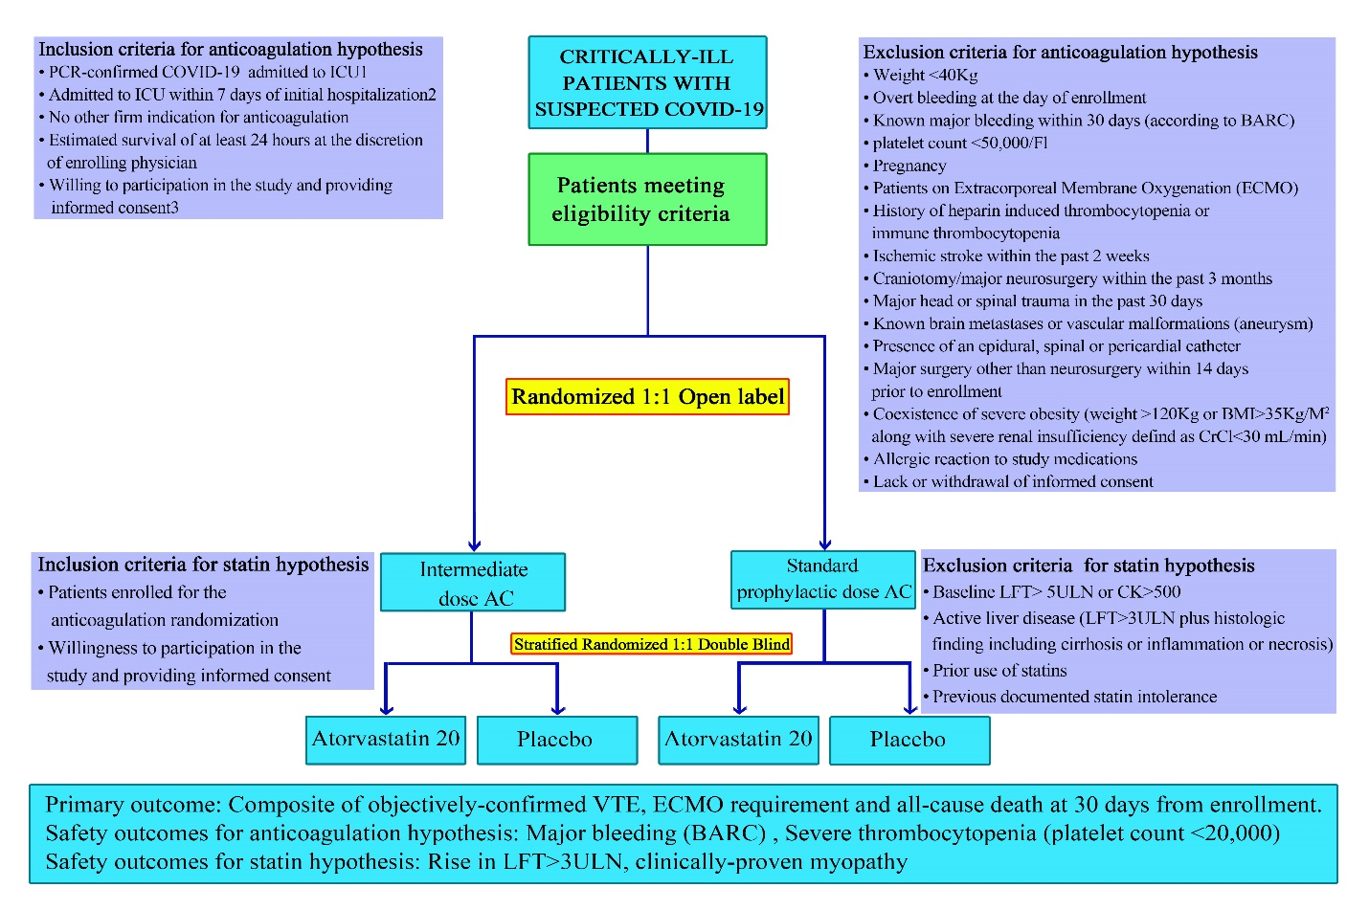
Study Flow Diagram

