Slide 1
بررسی عملکرد هوش مصنوعی در بررسی یافته های MRI قلب در بیماران مبتلا به تالاسمی
Artificial Intelligence Function in the evaluation of cardiac MRI findings in thalassemia patients

Slide 2
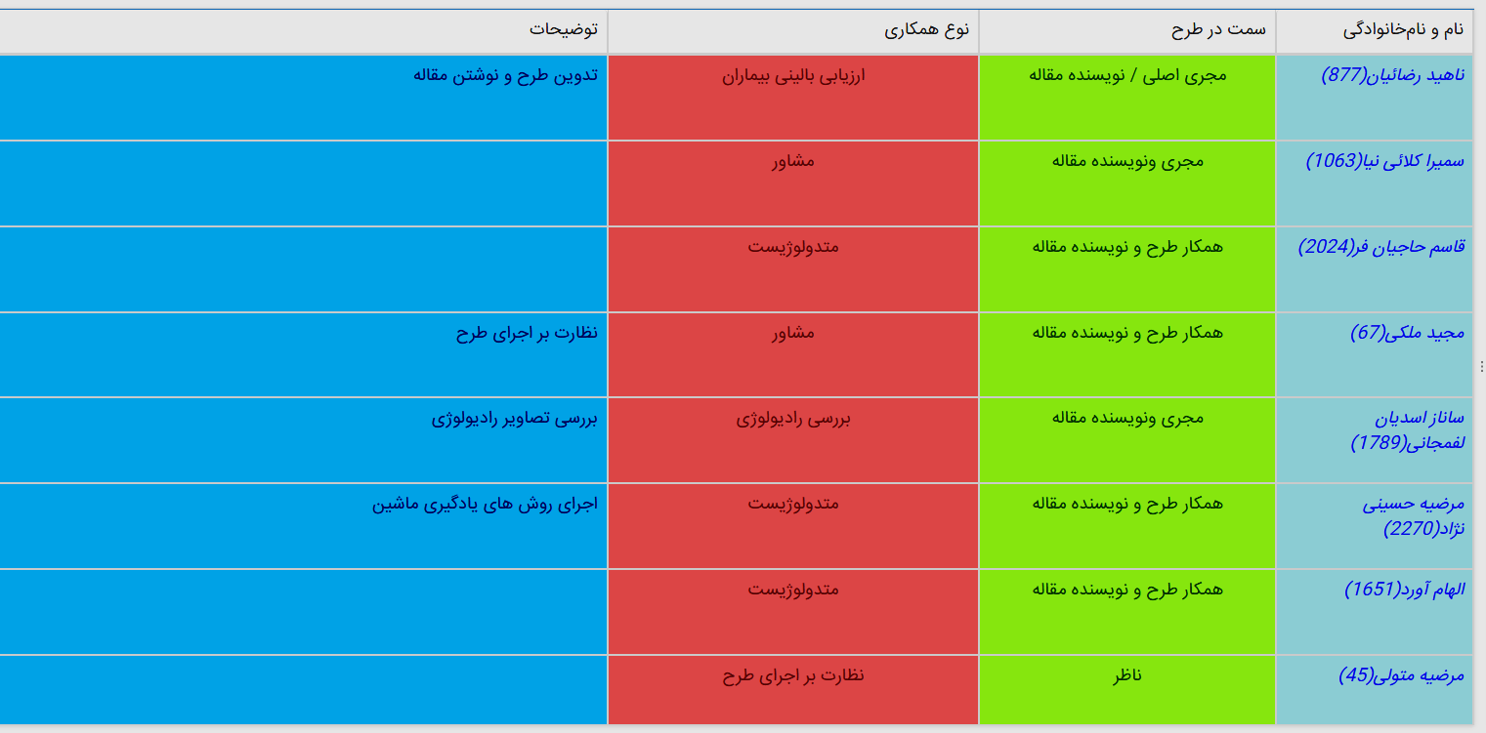
Manager/project associates

Slide 3
Overview of the problem
Thalassemia major is an essential type of anemia with autosomal recessive inheritance.
Like other countries in the region, thalassemia has a high prevalence in Iran. More than two million thalassemia carriers live in Iran, making further investigation necessary.
One of the main complications of thalassemia is iron overload, the deposition of which in the heart leads to cardiomyopathy.
MRI is the preferred method of examining the amount of excess iron overload in the myocardium. In this method, the iron overload of the heart is measured using the T2* method.
On the other hand, due to recent advances in artificial intelligence techniques, many advances have been made, and therefore we decided to use artificial intelligence techniques to estimate the amount of measured T2* in MRI accurately.
It is hoped that accurate methods in artificial intelligence will be helpful in the accurate evaluation of these patients according to the imaging findings.

Slide 4
Methods
In this study, we review cardiac MRI images of thalassemia patients referred to the MRI ward of Shahid Rajaei Heart Hospital and calculate the amount of cardiac iron overload and myocardial strain.
Then, we obtain the relationship between artificial intelligence models with MRI T2* and myocardial strain and analyze the findings of radiomic extracted from cardiovascular images.

Slide 5
Specific Aims
1. Determining the relationship between myocardial iron overload in cardiac MRI with artificial intelligence parameters
2. Determination of radiomics features from cardiac MRI images in predicting myocardial iron overload.

Slide 6
Costs
Specialized costs of bioinformatics department: 200,000,000 Rials

Slide 7
Thank you

